Slide 1

Enterprise Outage How to Enter/Update Contractor information October, 2011

Slide 2
Enterprise Outage Application
Enterprise Outage is the centralized program for entering and managing facility outage dates. This information is needed for multiple purposes.
Web Application functions similarly to RI.
Manufacturing Data is shared by all Reliability application – RI, MOC, Outage, MTT (Manufacturing Task Tracker)
Mfg data includes Site, Employee, Business Unit/Area, Roles
SME Resources: Technology Power, Pulp
Contractor Resources
Budget
Division Outage Schedule
Automated Manufacturing Daily Report
2

Slide 3
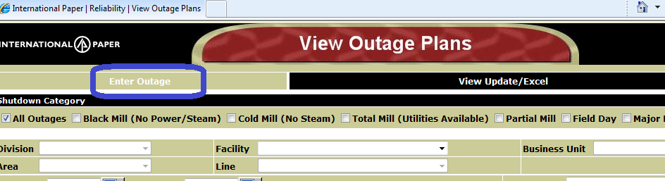
How to Enter Outage
Access Outage by typing “Outage” in Address bar of Internet Explorer
Click on “Enter Outage”

Slide 4
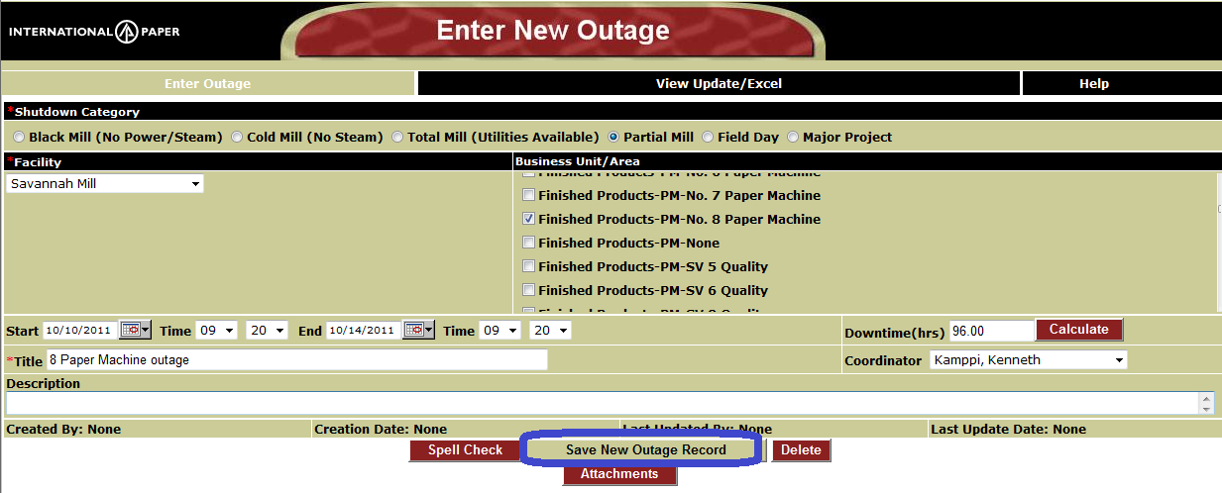
Enter an Outage Information
Select Shutdown Category
Choose Business Unit/Area(s)
Choose Start and End date and time of Outage
Type Title (less than 80 characters used on reports and to find for updating)
May enter more information in Description if needed
Select Coordinator
SAVE NEW OUTAGE RECORD

Slide 5
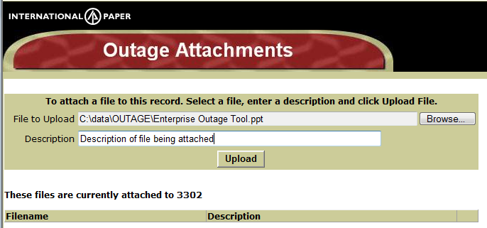
Adding Attachments
Attachments can be added immediately after the initial Outage information is Saved or at later date
Click on Attachments button on bottom of screen
Browse and select file to upload
Enter Description of File
Click Upload

Slide 6
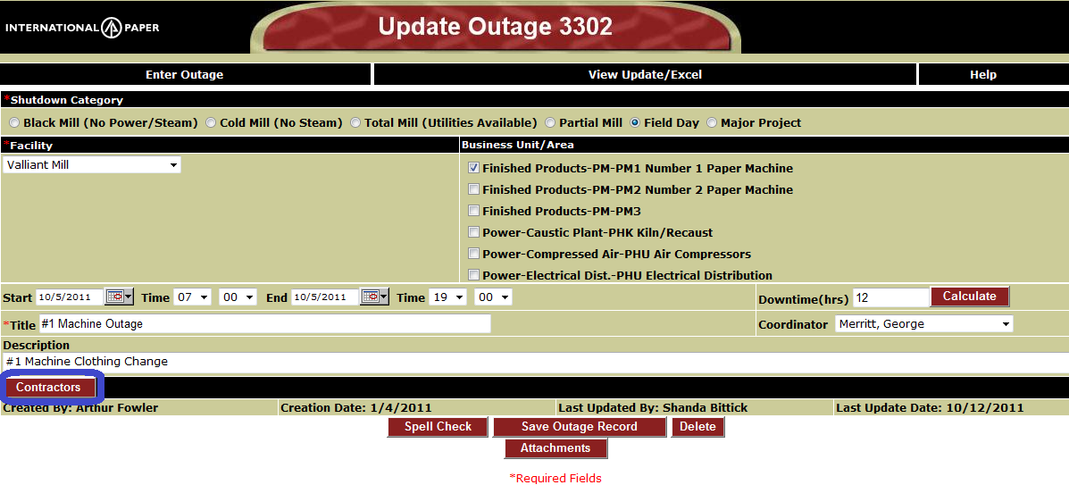
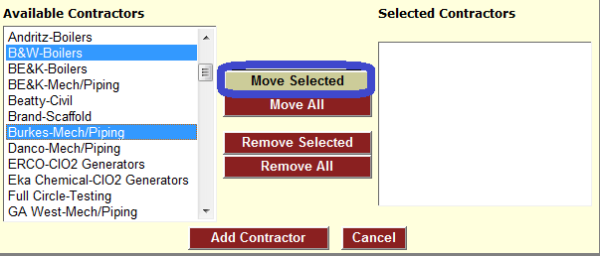
Adding Contractor Information
Step 1: After the Outage information has been saved (or when updating outage)
Click “Contractors” button
Step 2: Select Contractor - Type of work) and click “Move Selected”.
You may select multiple or just one at a time

Slide 7
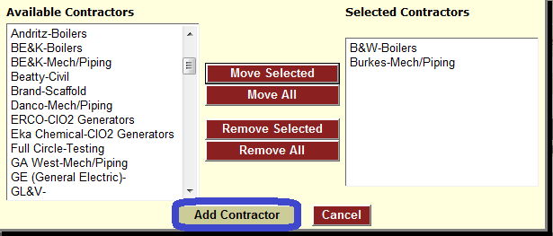
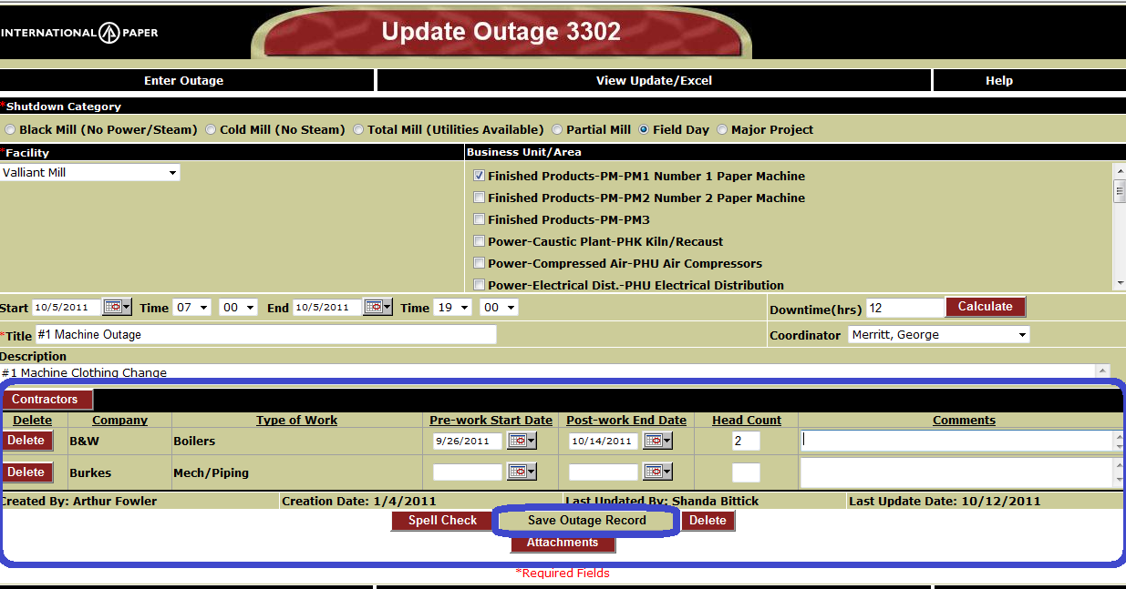
How to add Contractor Information
Step 3: After all Contractors have been selection (right hand side). Click “Add Contractor” button
Note: This is not a comprehensive list of contractors. If you would like to add additional names, contact Doug Todd.
Step 4: Contractors will be added to Outage record.
May enter more details (Pre-work or post-work dates), head count, and comments
REMEMBER to
SAVE OUTAGE RECORD

